Slide 1
ISRC Software Team
a quick review

Slide 2
projects
Fusarium
Crop Detection
LAI Biomass
Evaporation Transpiration
relay telephone based on Voip
IoT

Slide 3
Remote sensing software architecture

Slide 4
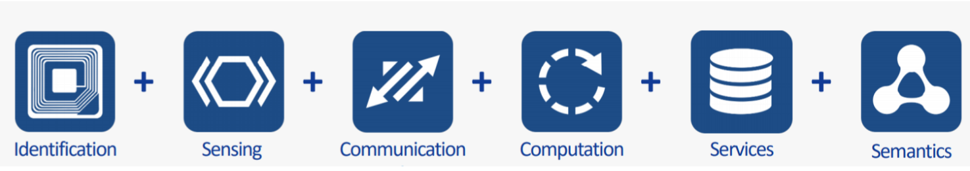
Internet of things

Slide 5
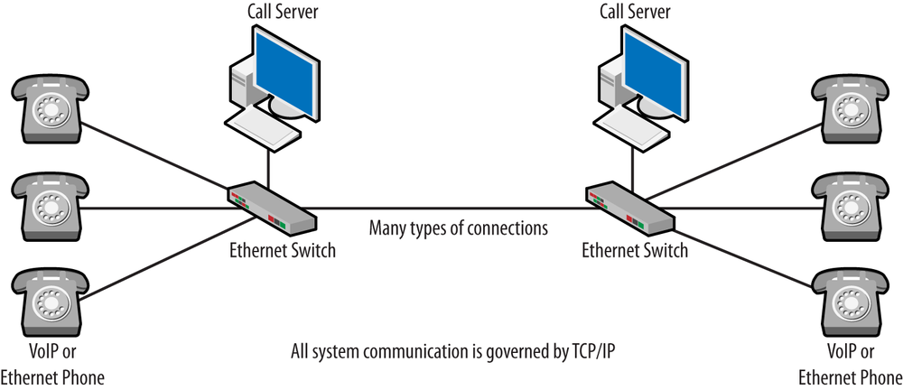
relay telephone based on Voip

Slide 6
Let’s have some practical samples
a quick review

